Slide 1
EVO Platinum Services group (EPSG)

Slide 2
What is a merchant account?
A merchant account is a type of bank account that allows businesses to accept payments in multiple ways, typically debit or credit cards. A merchant account is established under an agreement between an acceptor and a merchant acquiring bank for the settlement of payment card transactions. In some cases a payment processor, independent sales organization (ISO), or member service provider (MSP) is also a party to the merchant agreement. Whether a merchant enters into a merchant agreement directly with an acquiring bank or through an aggregator, the agreement contractually binds the merchant to obey the operating regulations established by the card associations.

Slide 3
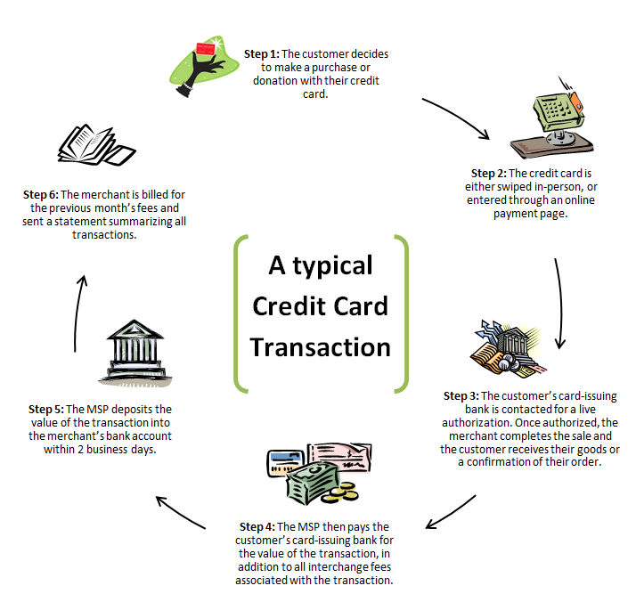
Credit Card Payment Process.

Slide 4
Illustrative video of what a merchant account is and how it works.
https://www.youtube.com/watch?v=avRkRuQsZ6M

Slide 5
How does it work?
Merchant service providers work as an intermediary between the bank, a person or organization wanting to receive funds and the person or organization looking to purchase goods or services. The merchant service provider will provide businesses and individuals with the necessary requirements to accept credit cards, debit cards, and other forms of electronic payment for the transaction to take place.

Slide 6
How does it work?
*For example, a retailer selling a product to a customer. The customer uses a payment card for the purchase, the merchant service provider will move the customer’s funds to that of the retailer. This can usually take up to 48 hours for these funds to be credited to the retailer's bank account. Some merchant service providers offer cash advance services to transfer funds faster.
*Merchant service providers typically require the merchant to have a merchant account with the provider, either directly or through a referral partner, such as banks or B2B service companies. All banks in the United Kingdom, except for Barclays/Barclaycard, offer merchant services by referring customers to a merchant service provider.

Slide 7
Rates and fees.
A merchant account has a variety of fees, some periodic, others charged on a per-item or percentage basis. Some fees are set by the merchant account provider, but the majority of the per-item and percentage fees are passed through the merchant account provider to the credit card issuing bank according to a schedule of rates called interchange fees, which are set by Visa, Discover, and MasterCard. Interchange fees vary depending on card type and the circumstances of the transaction. For example, if a transaction is made by swiping a card through a credit card terminal it will be in a different category than if it were keyed in manually.

